Slide 1
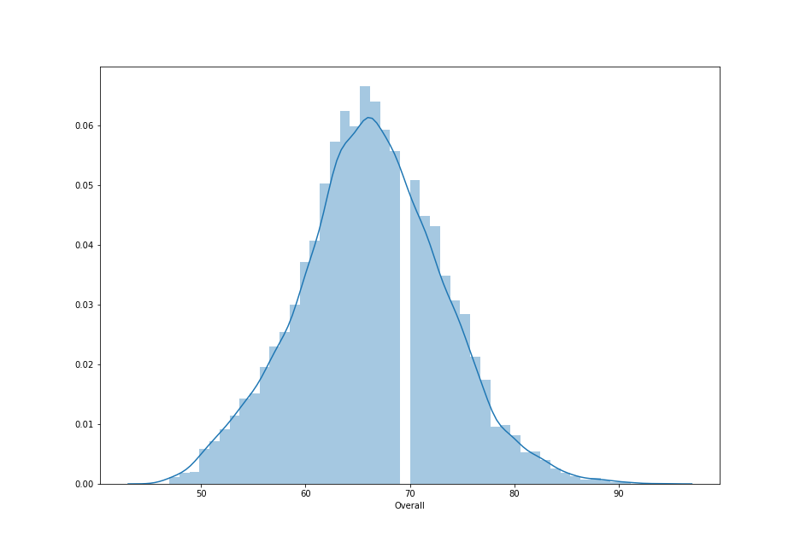
Distribution of Players with respective to Overall Rating

Slide 2
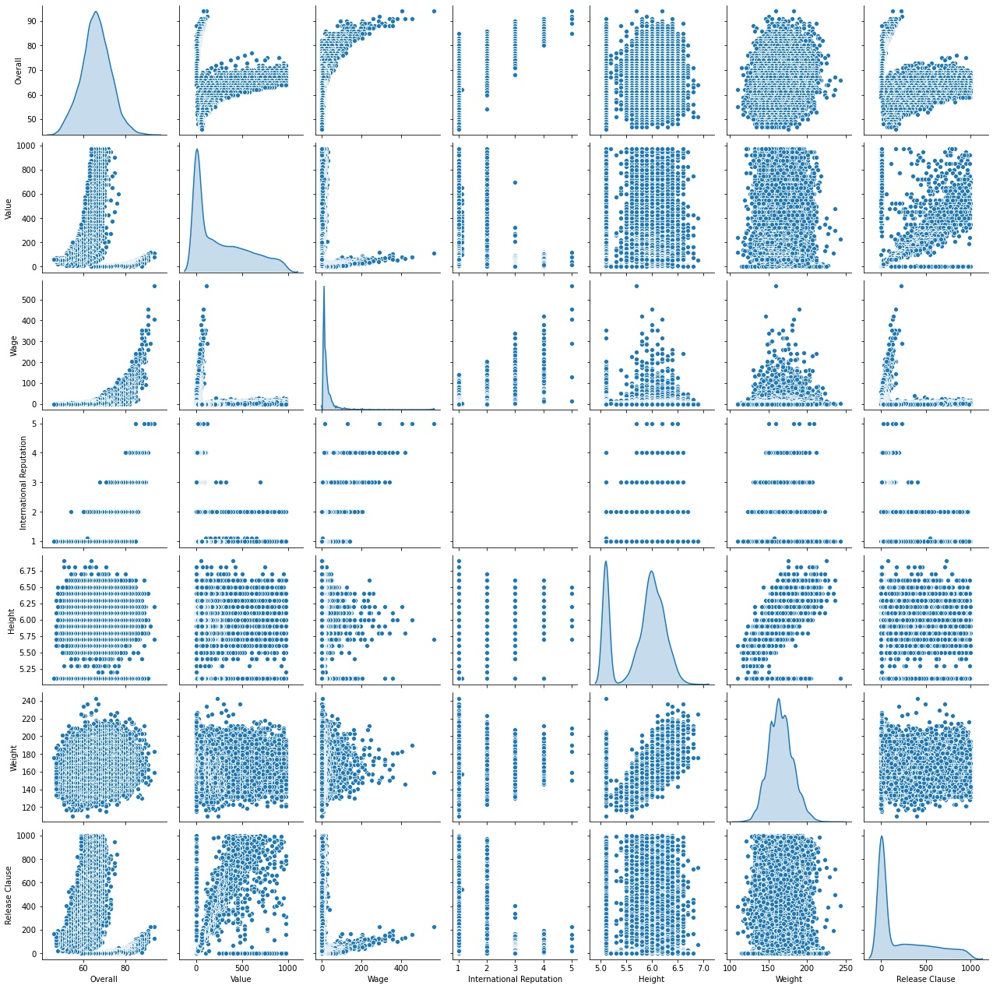
Pairplot of all the important variables

Slide 3
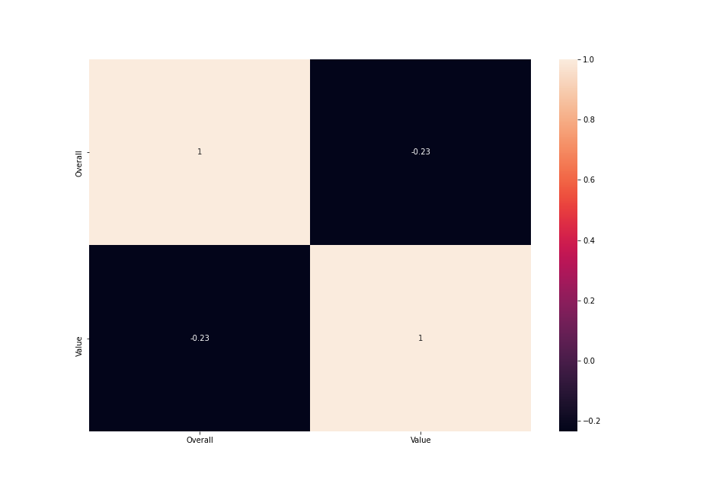
Correlation between value and Overall rating of player

Slide 4
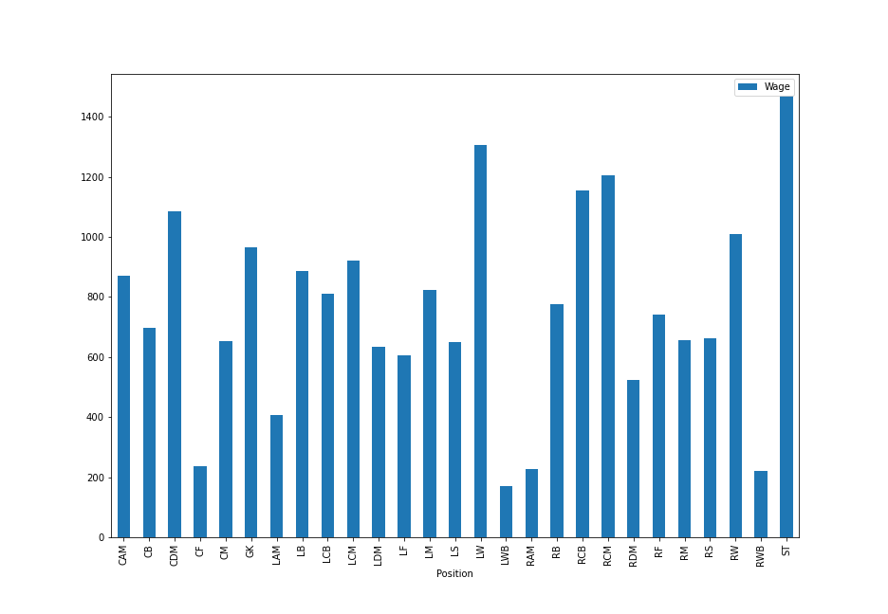
Average wages of top 5 players in each position

